Slide 1
JOB HUNT
"if opportunity doesn`t knock, build a door"

Slide 2

Agenda
About Team Members Introduction
Project Description AEIOU Framework Empathy Mapping Mind Map Ideation Canvas
Product Development Canvas Conclusion

Slide 3


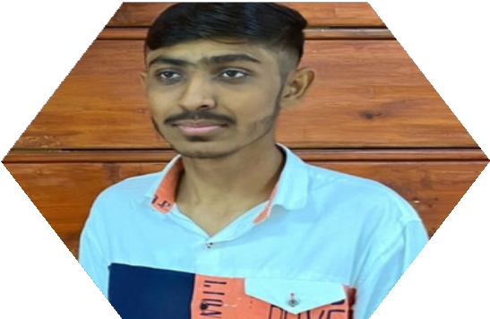
About Team Members
Hardik Pampaniya
200570107022
Parth Ahuja
200570107024
Yash Baldha
200570107012

Slide 4
INTRODUCTION

Slide 5










Slide 6
PRODUCT DESCRIPTION

Slide 7













































Slide 8
AEIOU FRAMEWORK

Slide 9
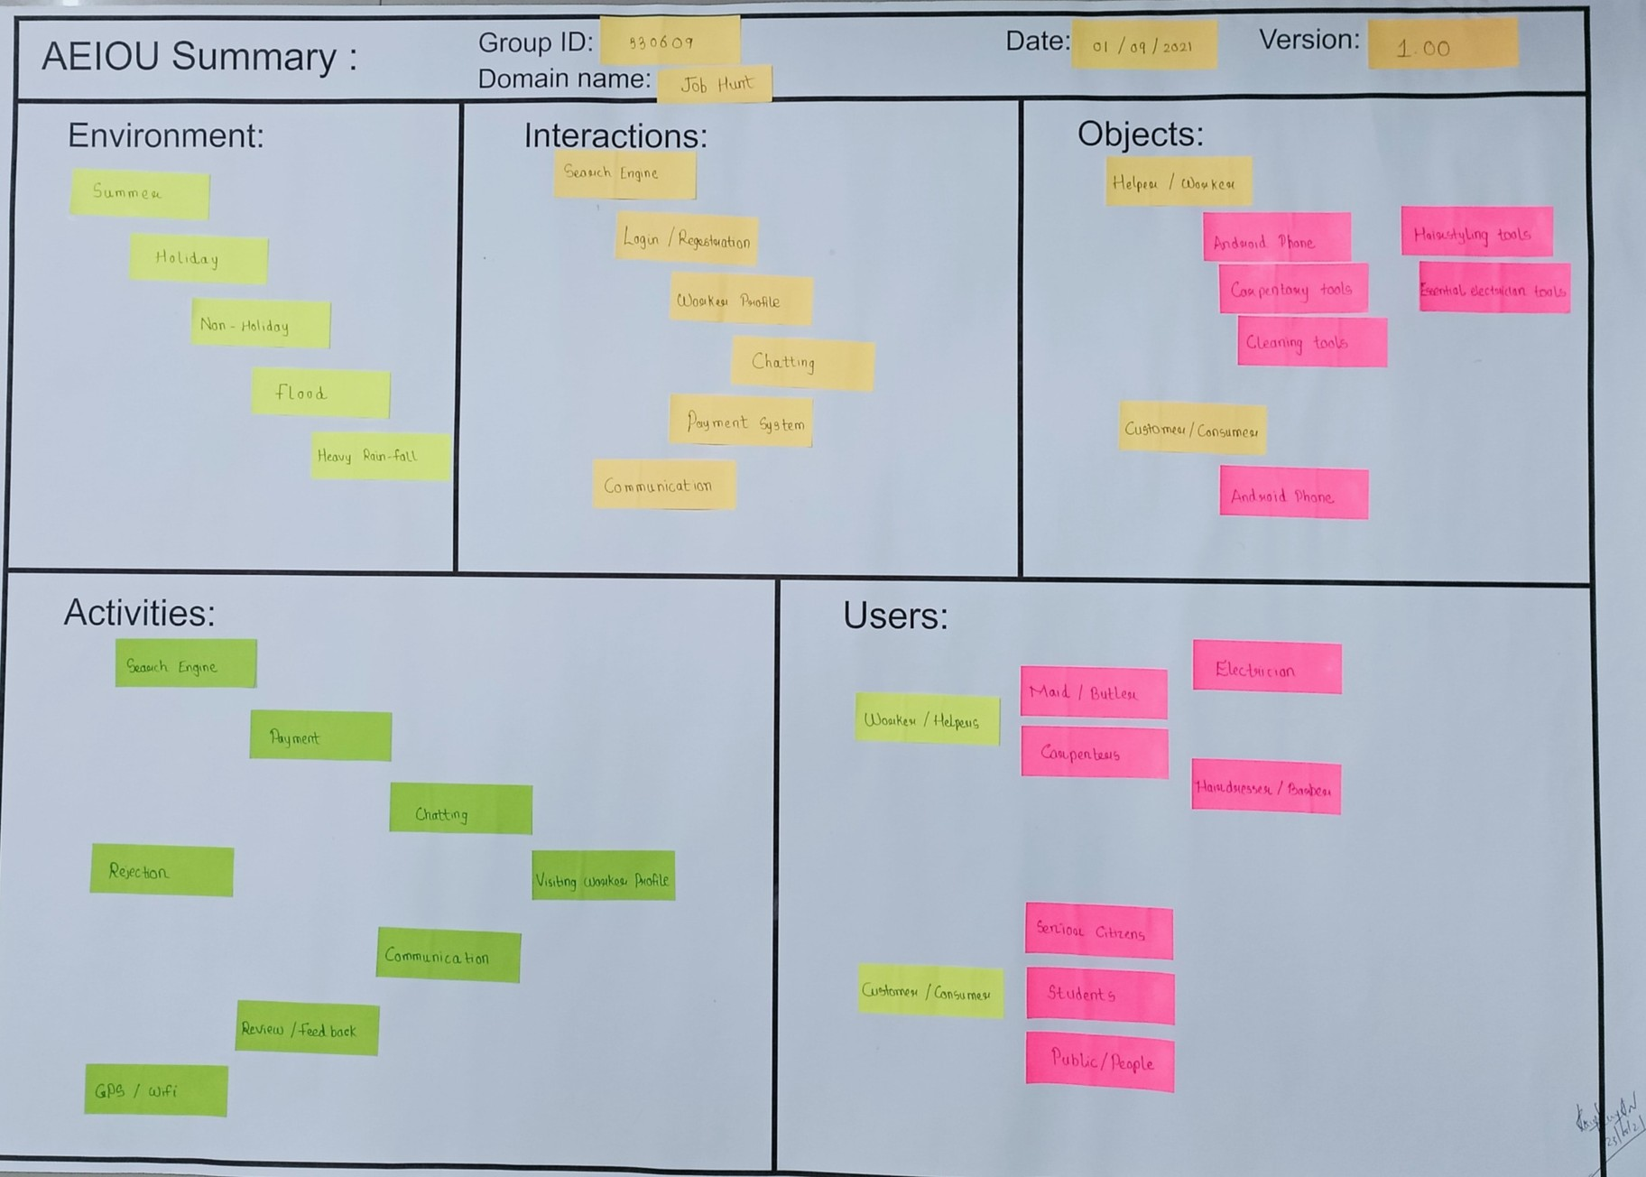

Slide 10
E N V I R O N M E N T
Summer Holiday
Non-Holiday Flood
Heavy Rain-fall

Slide 11
I N T E R A C T I O N S
Search Engine Login\Registration
Worker Profile Chatting Payment System Communication

Slide 12

O B J E C T S
Helper/Worker Android Phone Carpentary Tools
Cleaning Tools Hairstyling Tools Essential Electric Tools
Customer/Consumer
Android Phone

Slide 13
A C T I V I T I E S
Search Engine Payment Chatting
Rejection
Visiting Worker Profile Communication Review/Feedback
GPS/WIFI

Slide 14
U S E R S
Helper/Worker IOS Developer Carpenters Electrician
Hairdresser/Barber
Customer/Consumer
Senior Citizens Students Public/People

Slide 15
EMPATHY MAPPING

Slide 16
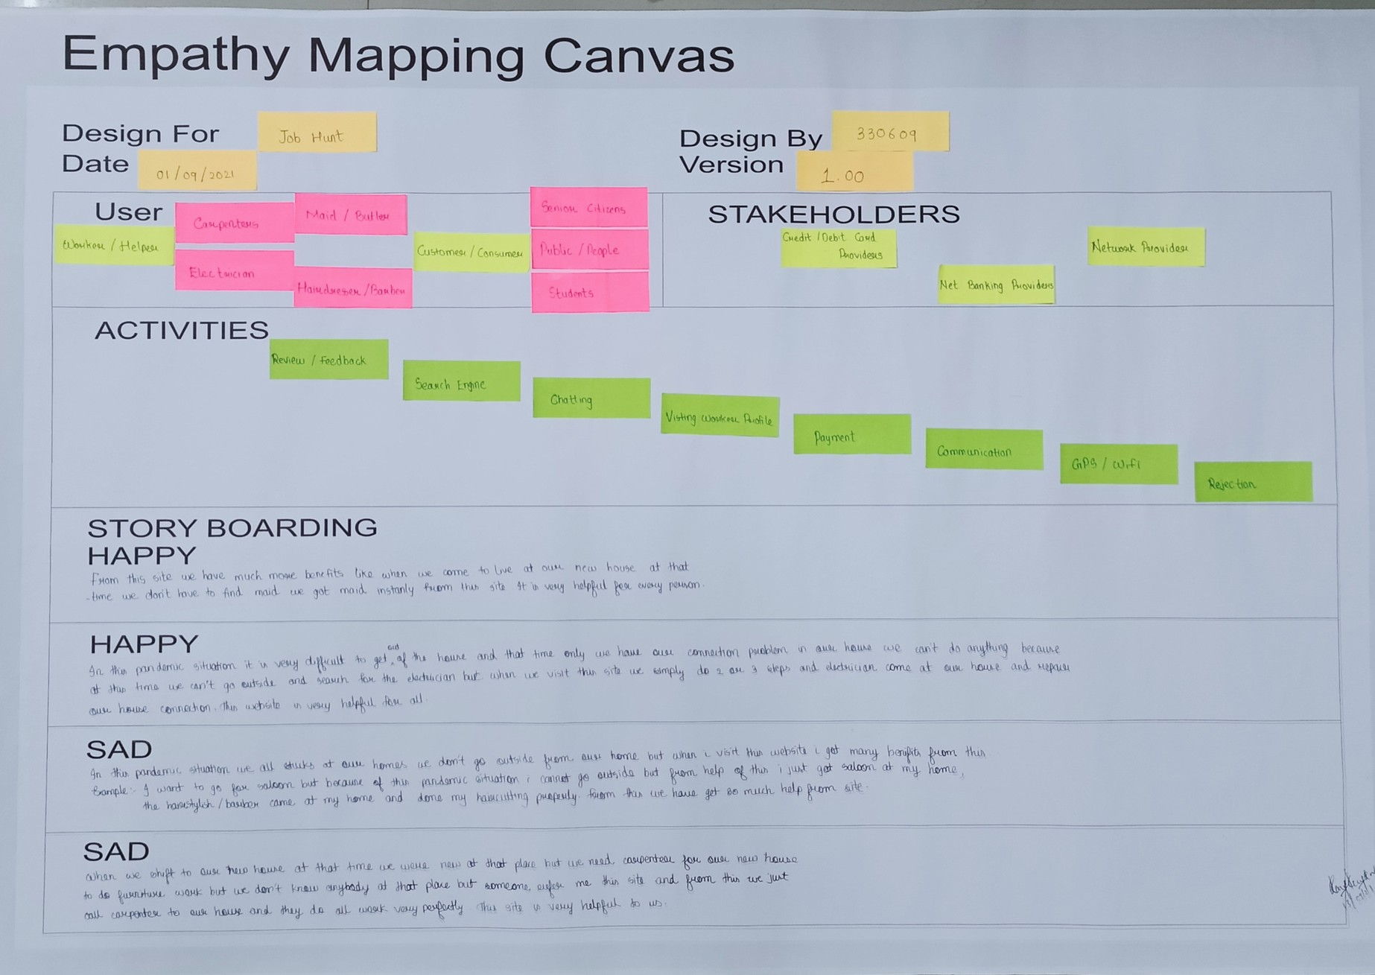

Slide 17
U S E R S
Helper/Worker Maid/Butler Graphic Designer Electrician Hairdresser/Barber
Customer/Consumer
Senior Citizens Students Public/People

Slide 18

S T A K E H O L D E R S
Credit/Debit Card Providers
Net Banking Provider Network Provider

Slide 19
A C T I V I T I E S
Search Engine Payment Chatting
Rejection
Visiting Worker Profile Communication Review/Feedback
GPS/WIFI

Slide 20
S T O R Y B O A R D I N G
- H A P P Y
From this site we have much more benefits like when we come to live at our new house at that time we don`t have to find maid we got maid instanly from this site.It is very helpful for every person.

Slide 21

S T O R Y B O A R D I N G
- H A P P Y
In the pandemic situation it is very difficult to get out of the house and at that time only we have connection problem in our house, we can`t do anything because at this time we can`t go outside and search for the electrician but when we visit this site we do simply 2 or 3 steps and electrician came at our house and repair our house connection problem. This website is very helpful for all.

Slide 22
S T O R Y B O A R D I N G
- S A D
In This Pandemic Situation we all stucks at our home,we can`t go outside from our house but when i visit this website i got many benefits from this.
Ex :- I want to go fot saloon but because of the
pandemic situation i can`t go outside but from help of this i just got saloon at my home,the hairstylish/barber came at my home and done my haircutting properly. From this site we have got so
much help.

Slide 23
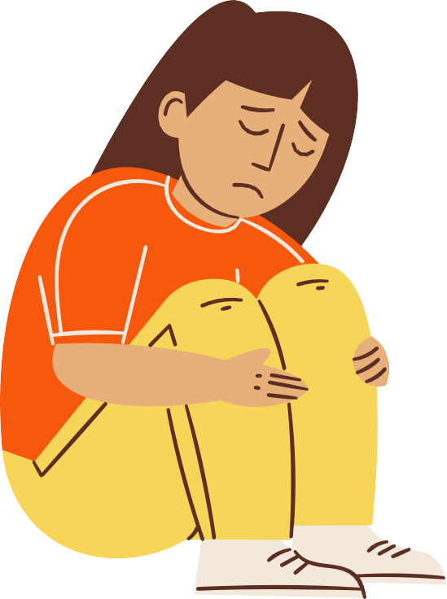
S T O R Y B O A R D I N G
- S A D
When we shift to our new house at that time we were new at that place but we need carpenter for our new house to do furniture work but we don`t know anybody at that place but someone refer me this site and from this we have to just call carpenter and he came and do all the work at our house.

Slide 24

MIND MAP

Slide 25
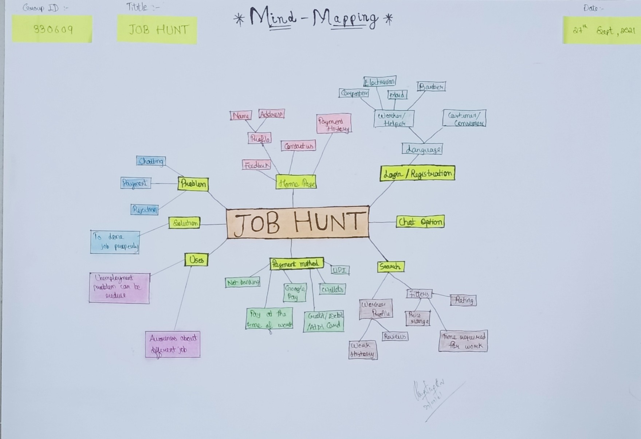

Slide 26

IDEATION CANVAS

Slide 27
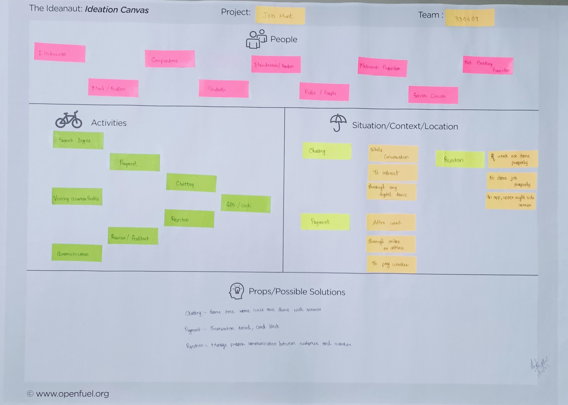

Slide 28
P E O P L E
Maid/Butler Carpenters Electrician Hairdresser/Barber
Web/App Developer
Senior Citizens Students Public/People Network Provider

Slide 29
A C T I V I T I E S
Search Engine Payment Chatting
Rejection
Visiting Worker Profile Communication Review/Feedback
GPS/WIFI

Slide 30
S I T U A T I O N
/ C O N T E X T
/ L O C A T I O N
Chatting
Payment
Rejection
While Conversation
After work
If work not done properly
To Interact
Through online or
offine
To done job properly
Through any digital
device
To pay worker
In app, upper right side corner

Slide 31
P R O P S
/ P O S S I B L E
S O L U T I O N S
Chatting
:- Some time some issue are there with server
Payment :- Transaction denied, card block
Rejection :- Manage proper communication
between customer and worker

Slide 32
PRODUCT
DEVELOPMENT CANVAS

Slide 33
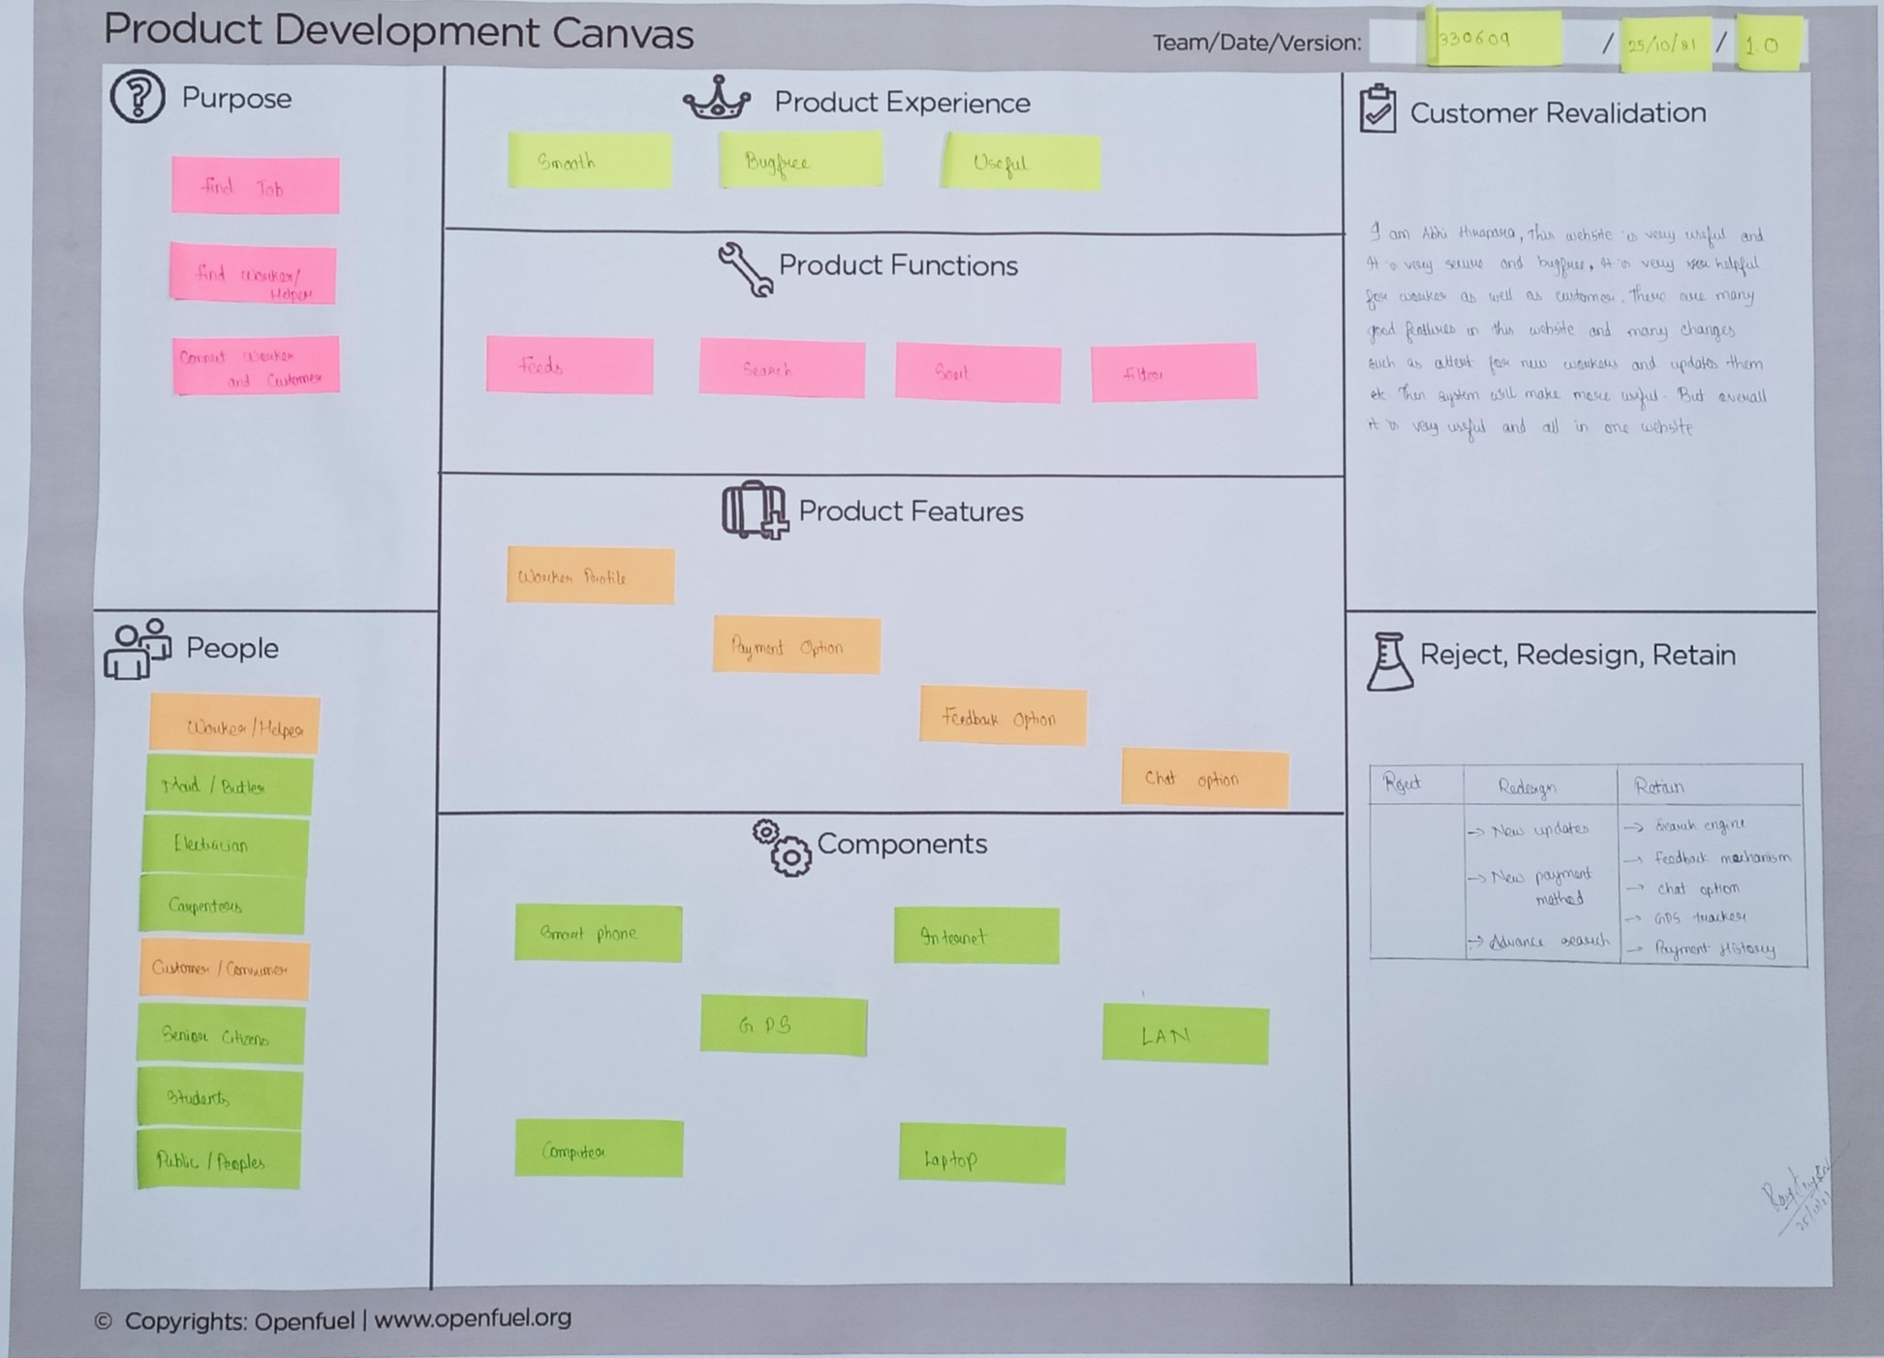

Slide 34
P U R P O S E
Find Job
Find Worker/Helper
Connect Worker and Customer

Slide 35
P E O P L E
Helper/Worker Maid/Butler Carpenters Electrician
Web Developers
Customer/Consumer
Senior Citizens Students Public/People

Slide 36
P R O D U C T
E X P E R I E N C E
Smooth
Bugfree Useful

Slide 37

P R O D U C T
F U N C T I O N S
Feeds Search
Sort Filter

Slide 38
P R O D U C T
F E A T U R E S
Worker Profile Payment Option
Feedback Option Chat Option

Slide 39
C O M P O N E N T S
Smart Phone Internet
Computer Laptop
GPS LAN

Slide 40
C U S T O M E R
R E V A I D A T I O N
I am Abhi Hirapara. This website is very useful and it is very secure and bugfree , it is very helpful for worker as well as customer.
There are many good features in this website and many changes such as atleast for new workers and updates them etc, then system will make more useful . But overall its is very useful and all in one website.

Slide 41
Reject
R E J E C T,,, R E D E S I G N,,, R E T A I N
Redesign
Retain
Search Engine
New Updates
Feedback Mechanism
New Payment Method
Chat Option
GPS Tracker Payment History
Advance Search

Slide 42
WIRE FRAME

Slide 43
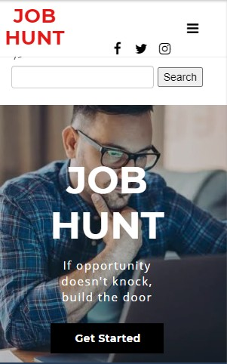
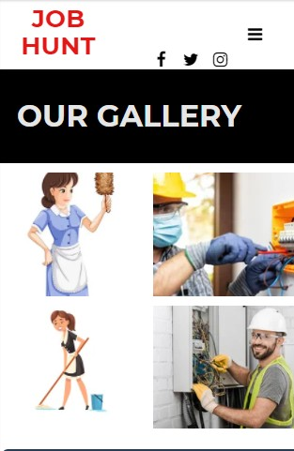
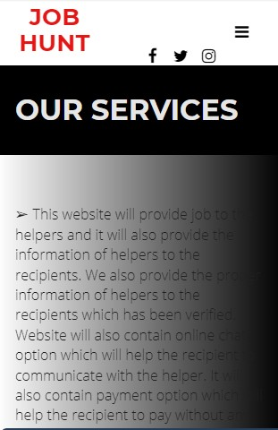
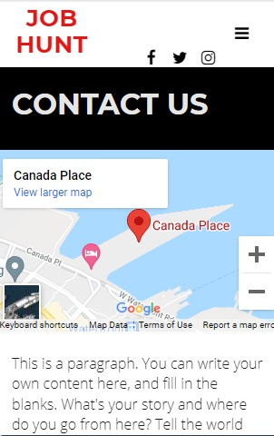

Slide 44
CONCLUSION

Slide 45

















































=

Slide 46
Thank you!
Feel free to approach us if you have any questions.

